Slide 1
301 Oct 6, Class 9
Chapter 8, Within-participants design

Slide 2
In an effort to determine the effects of the drug chlorpromazine on the cognitive performance of schizophrenics, two clinical investigators randomly selected 20 acute schizophrenics from a mental hospital population.
The patients were asked to order several stimuli along some dimension, such as ordering eight stimuli by weight.
There were several tasks of this sort.
The investigators used a within-participant design in which all participants first performed the tasks after being injected with a saline solution (placebo) and then performed the tasks again several hours later after being injected with chlorpromazine.
The results indicated that fewer errors were made in the chlorpromazine treatment, which suggested to the investigators that the drug facilitates more adequate cognitive functioning in this type of patient.

Slide 3
Within-participants design
Generally better
  Except when it’s not
Advantages
  Highly efficient. Each participant provides data in all conditions so accumulating data collection towards the planned number of participants is more rapid.
  Perfect control of participant variables. Since all participants provided data on all conditions, the conditions are exactly matched for all extraneous variables related to the participants on the task, e.g., motivation, attention, ability.

Slide 4
Within-participant design concerns
History effects: carryover, learning, fatigue
  Counterbalance order across participants
  Be aware when this doesn’t work
    Can require a factorial analysis (Chapters 9-11)
Participants aware of all IV levels
  Might be aware of the experimental hypothesis
  Might therefore be biased in responding

Slide 5
Questions
1. Why is it generally impractical to use a within-participants design in studies that have an element of deception (e.g., the implicit bias studies)?
2. For a study assessing time to recognize famous faces upside-down, why would a within-participants design be a good idea? Give two reasons.
3. Why are mood manipulation studies difficult to do as a within-participants design?
4. Why are learning-based studies difficult to do as a within-participants design?

Slide 6
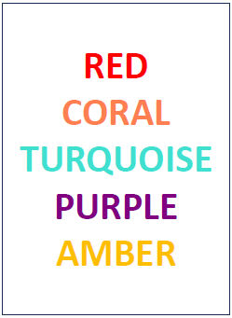
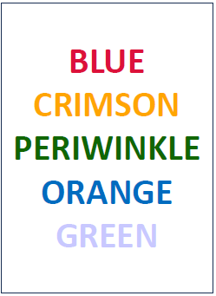
Stroop

Slide 7
Design for observing the Stroop effect
Participant variables that affect the DV
  Controlled by within-participant design
Cognitive paradigms where stimuli can be mixed
  DV measured on each trial
  Eliminates order effects
  Stroop originally measured in 1930s

Slide 8
Jones wondered if infants might begin the social control of facial expressions, including smiles even earlier than 18m. A laboratory testing situation was set up to observe 10m-old babies with their mothers. Two conditions were tested. In one, the mother paid attention to the baby for 6 min; in the other she read a magazine for 6 min. The baby was videotaped and smiles were later scored by judges who viewed the tapes. Babies smiled at their mothers more often when their mothers were attentive.

Slide 9
 | Mom watching | Mom reading
SN | 12 | 6
JF | 8 | 7
KM | 4 | 3
GB | 2 | 0
SB | 18 | 15
Avg | 8.8 (2.9) | 6.2 (2.5)

Slide 10
Smiling
Two-sample t-test assuming equal variances, t(8)=0.69, p>0.65

Slide 11
Smiling
Paired t-test, t(4)=2.83, p< .05

Slide 12
For Wed Oct 8
Chapter 9, Ethics
Experiment 1 writeup due end of day
First Midterm on Friday
  Prior exams available in Canvas as a study guide

